Slide 1


AGILE DEVELOPMENT

Slide 2

Explaining agile Roles
Product Owner
Ensures that the development team understands the project based on what the client wants and assists on making that vision happen through communication backlogs and meetings with the client/development team.
Scrum Master
Provides guidance for the team in the agile process
Helps with organizing the process to help development and enforce the vision of the project.
Facilitates Scrum events.
Development Team
Consisting of Developers and Testers
Develop the program and build test cases
Communicate with each other and the rest of
the scrum team to complete the project.

Slide 3

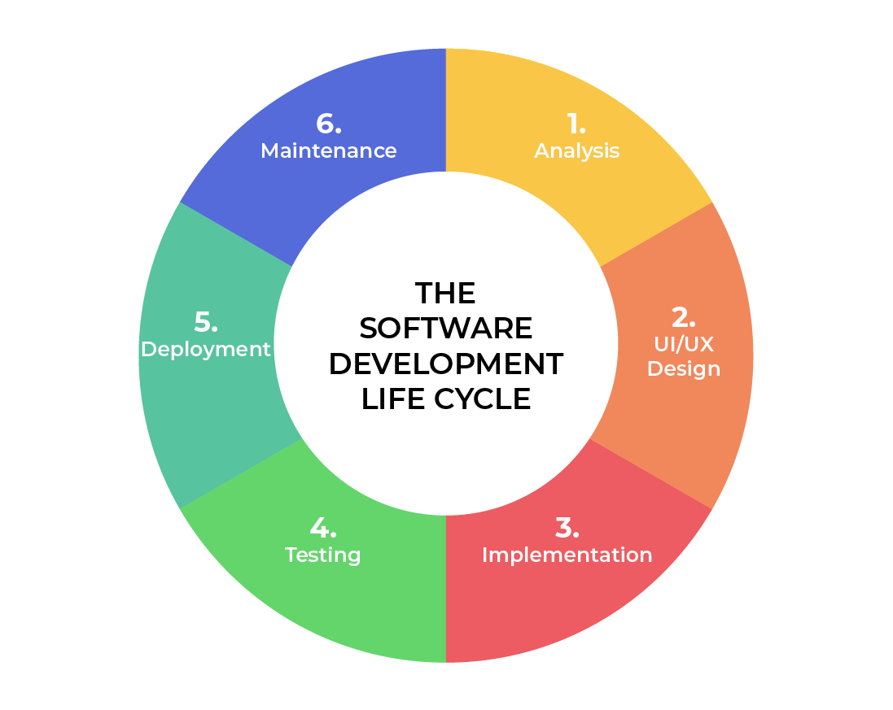
SOFTWARE DEVELOPMENT LIFECYCLE
Analysis
Collaborate with stakeholders.
Gather Requirements.
Design
Define detailed process for functionality.
Define technologies, limitations, time frames and budget.
Implementation
Development begins.
Functionality is broken up into smaller increments.
Testing
Occurs In conjunction with Development.
Process for identifying and mitigating reported defects and issue tracking.
Deployment
Testing complete and product is released to market.
Maintenance
Product in production environment.
Developers must be ready to implement NEW features and bug fixes as they come up.
Notes:
Analysis – This is the basic building block of the software development lifecycle. This is where leadership collaborates with various stakeholders to collect the requirements of the project.
Design – In this phase, the functionality is defined in detail. The technologies used and project resources, limitations, time frames and budgets are also discussed.
Development – In this phase, the development begins. The programming language used is dependent on the project. This is the longest phase in the SDLC because each functionality is broken into smaller increments to allow for value-based code development.
Testing – During the testing phase test cases are made to ensure the program functions this can be done in conjunction with development especially if they are utilizing test driven development. This should also happen at all phases but specifically reserved for defects and issue tracking with existing code base because it is better to be proactive during agile development.
Deployment – In this stage, testing is complete, and the product is ready to be deployed to market. UAT (User Acceptance Testing) may be performed in a limited environment before releasing to market.
Maintenance – In this stage, the product has been deployed into market. Developers must be ready and able to address any new features and bug fixes that users request and experience in production.

Slide 4
vs
Agile Method
Waterfall Method
Not all requirements are required.
Major requirements can be defined but functionality can evolve over time.
No time to market constraint
All requirements must be defined.
Contract Negotiation.
Sequential/Linear stages.
Best for simple, unchanging projects
Notes:
The SNHU Travel project would have been difficult to complete under a waterfall approach. Given the amount of uncertainty any changes. This would have had a negative impact on the project and taken longer than the desired timeline. Even with the high level of uncertainty with agile, any issues discovered would require a change order to the agreement which can be costly. Agile method makes it easier to adapt to the changes through iterative development. The idea with agile is get the basic functionality to work than make updates as needed along the way to create a more well-rounded system.

Slide 5
References
Charles G. Cobb. (2015). The Project Manager’s Guide
to Mastering Agile : Principles and Practices for an Adaptive Approach. Wiley.

